Slide 1
HUMAN BODY POSE ESTIMATION BY PYCHARM
Created by:
Aditi Jain
Sahil Sigroha

Slide 2
Acknowledgement
We would like to express our special thanks and gratitude to our guide Mr. Utkarsh Tiwary sir, Mr. Purushottam Sharma as well as Mr. Anil Gupta sir who gave us the golden opportunity to do this wonderful project on the topic Human Body Pose Estimation, which also helped us in doing a lot of research and we came to know about so many new things.
We are really thankful to all of them, moreover, it also helped us in increasing our knowledge and skills.

Slide 3
OBJECTIVE
Pose estimation is a computer vision technique that is used to predict the configuration of the body(POSE) from an image. The reason for its importance is the abundance of applications that can benefit from technology. Moreover, the applications of pose estimation are sign language to help the disabled, human tracking, gaming, action recognitiuon, etc.
The main process of human pose estimation includes two basic steps:
i) localizing human body joints/key points – main focus is on finding the location of each key points of human beings.
ii) grouping those joints into valid human pose configuration – grouping joints into valid human configuration.
OpenCV Python library is used to solve computer vision problems, basically analysing features like object detection.
In the project we will detect 33 different landmarks of human body that is used to track best pose estimation, is displayed in the next slide.
The pose can be detected either by playing video or by real time.

Slide 4
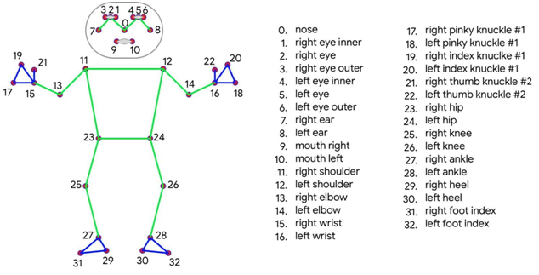
Different Landmarks of human Body

Slide 5
IMPLEMENTATION ALGORITHM
Creating a folder for video, then creating a file for pose estimation.
Some libraries are needed to start the estimation like import cv2, mediapipe, and time.
Reading the video by : cap = cv2.VideoCapture(‘Video name’) and displaying the frame rate by mentioning pTime=0 (previous time) and cTime=time.time() (current time).
Creating a model object to detect pose for which we need to convert BGR image from mediapipe to RGB, and displaying the result after converting image colour by following command : result=pose.process(imgRGB).
First we will print the landmark of human body (joints) by using the command: print(results.pose_landmarks)
Then applying the ‘if statement’ condition to join the landmarks and from lines along them.
To sort landmark we use the following command:
(results.pose_landmarks.landmark) using enumerate to get the loop count convert landmark (height, width and channel) to pixels by lm.x*w.
In the end, making an empty list and appending to highlight a particular landmark

Slide 6
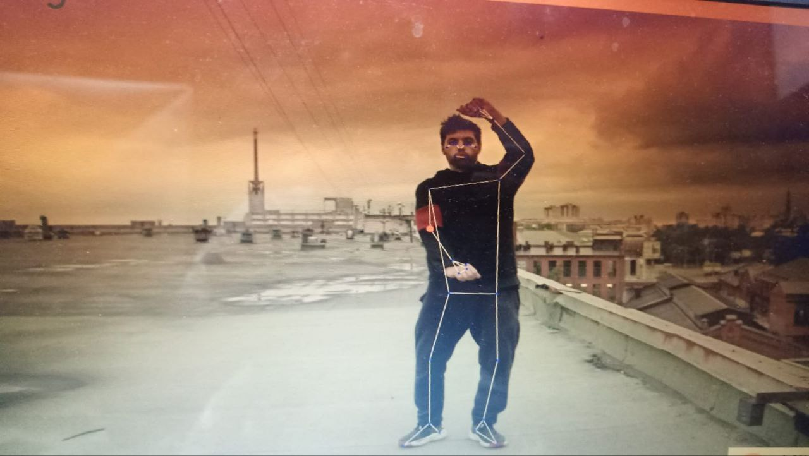
CONCLUSION
The output is shown in the image on the side following the lines along the body structure and landmarks connecting the joints of human body.

Slide 7
Thank You

